Slide 1
Food For All (FFA)

Slide 2
FFA Mission
Our world population is expected to grow from 7.3 billion today to 9.7 billion in the year 2050.
Finding solutions for feeding the growing world population has become a hot topic for food and agriculture organizations, entrepreneurs, activists, and philanthropists.
Food For All (FFA), a non-profit organization dedicated to fighting hunger and poverty across the globe margining innovative technologies and sustainability practices. FFA is concerned about the availability of food for the world’s most vulnerable population.

Slide 3
Exploratory Data Analysis (Data Source)
The Food and Agriculture Organization of the United Nations
245 countries and territories, from the year 1961 to 2013
https://www.kaggle.com/roshansharma/world-food-production/data

Slide 4
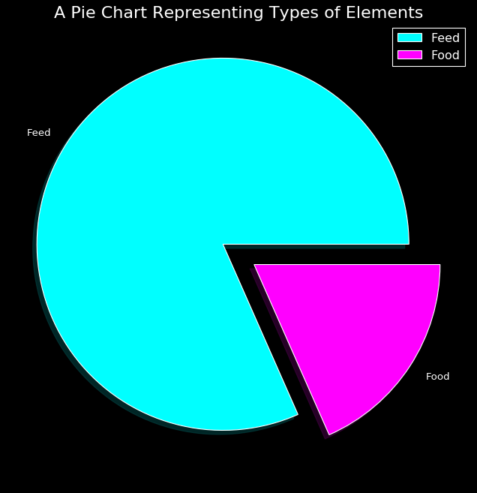
World Feed vs. Food Production

Slide 5
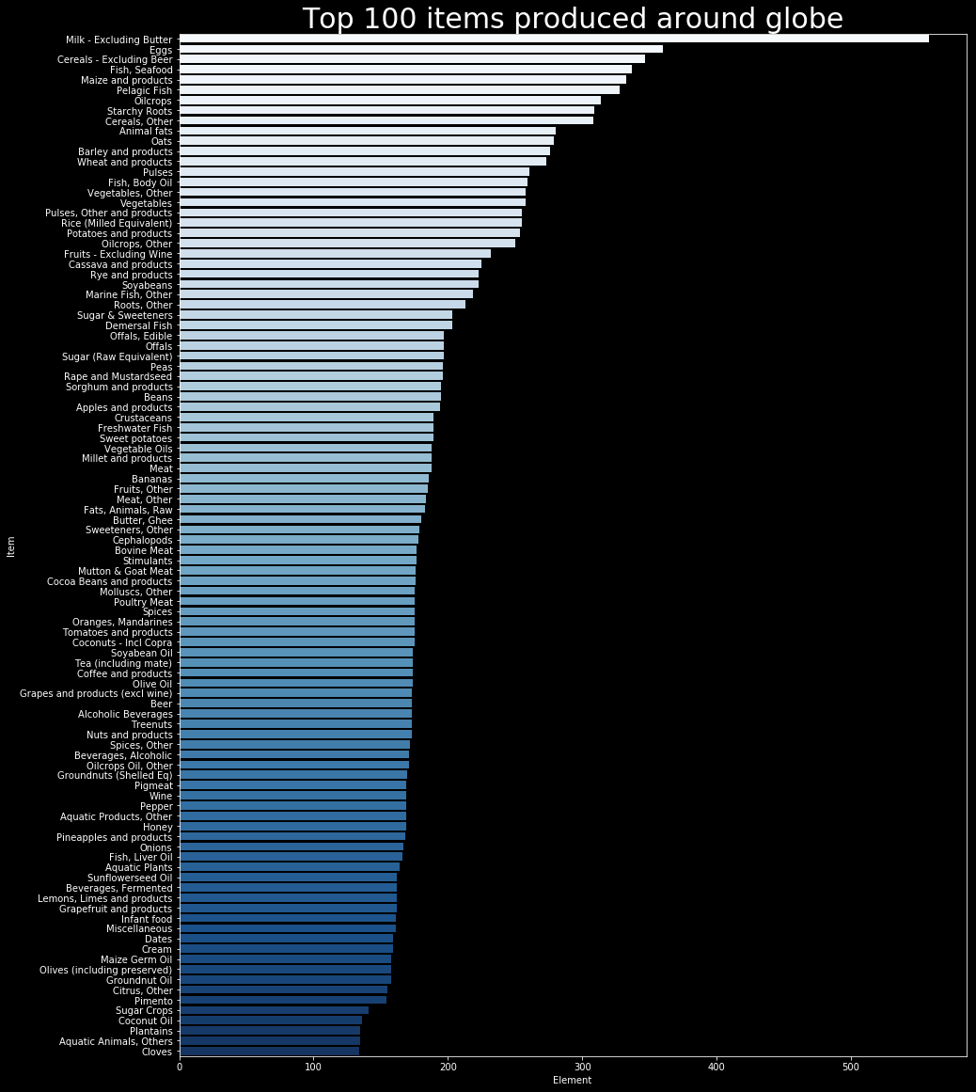

Slide 6
Objective
Conduct an EDA of world food consumption.
Identifying marketplaces for alternative types of “milk”.

Slide 7
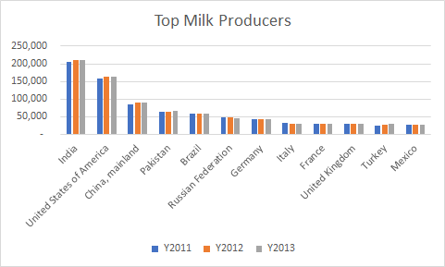

Slide 8
If We Had More Time, the TEAM would:
Refine our research questions
Merge the data with population data
Consider food culture

